Slide 1

LOST PUCK
Web Systems F’21
Chloe Jepson, Lubna Ismail,
Paul Jang, Rex Yu
Notes:
Chloe

Slide 2
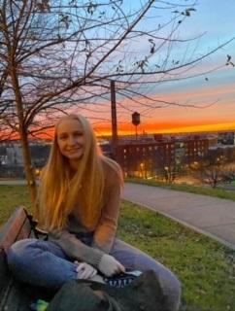
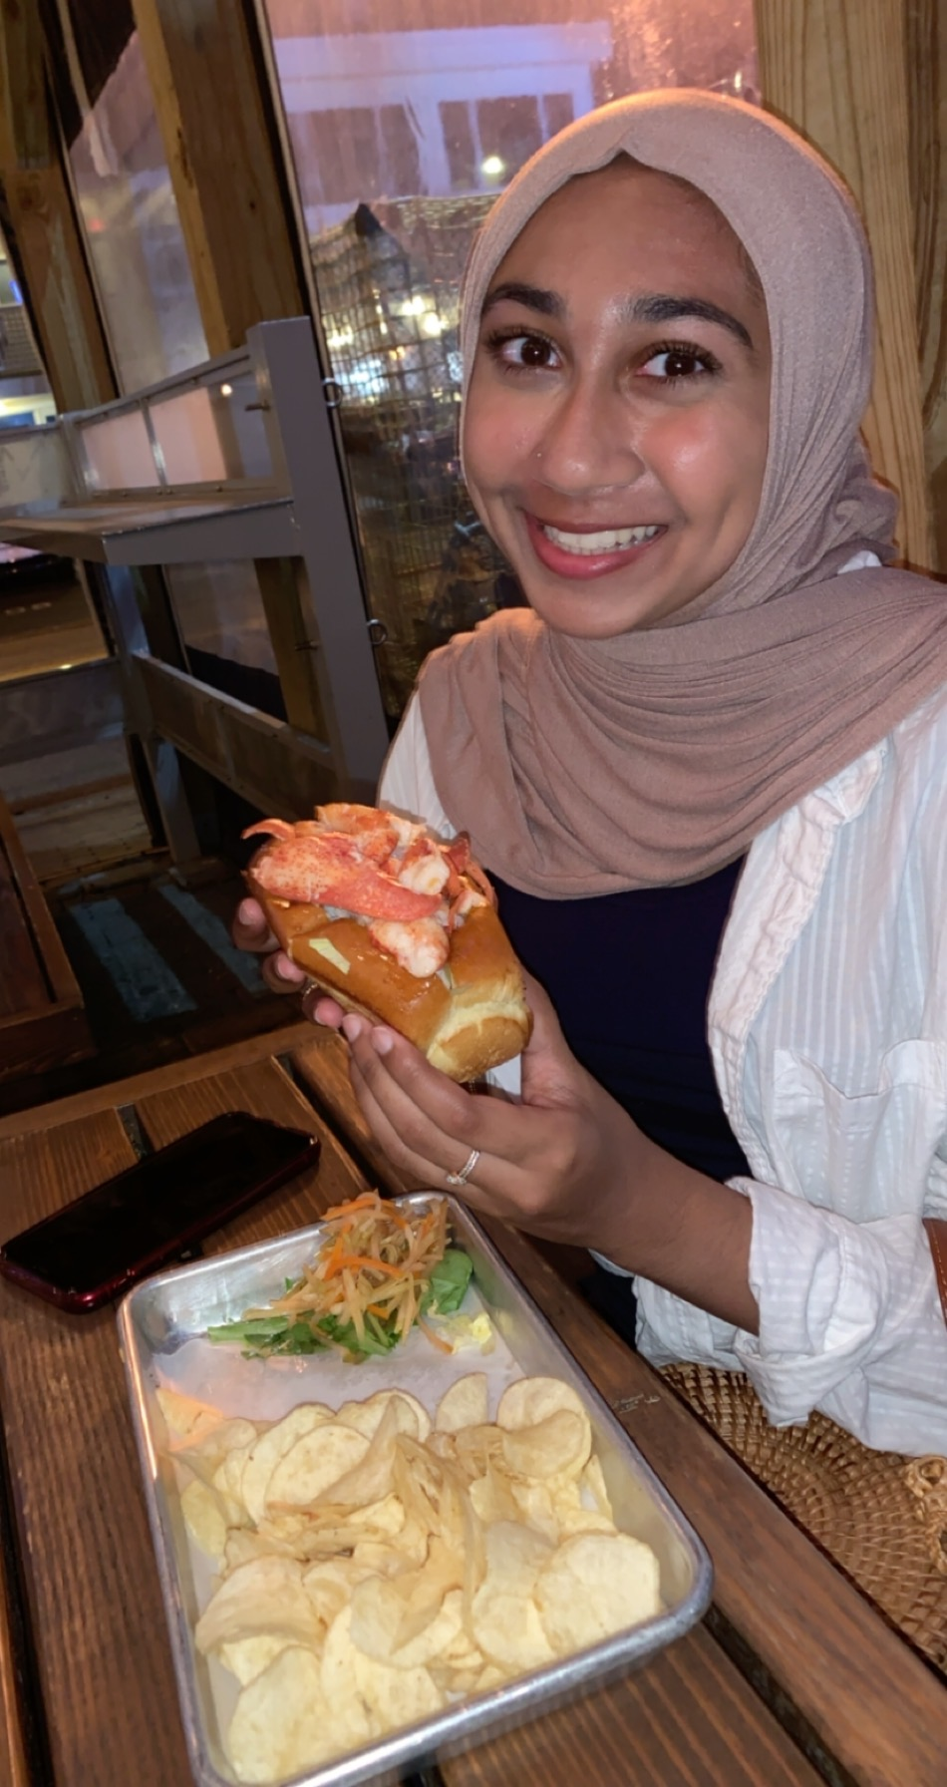
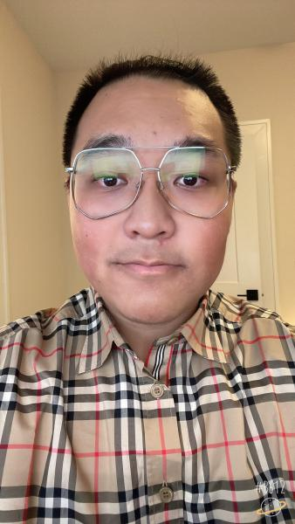


Meet The Team
Chloe Jepson
ITWS 24
Lubna Ismail
ITWS 24
Rex Yu
BSAN 23
Paul Jang
ITWS 23
Notes:
Chloe

Slide 3
Agenda
Problem statement
Solution
Structure
Stakeholders
Tech involved
Non-functional requirement
Functional requirements
Demo
Improvements/ future developments
Notes:
Chloe

Slide 4
Problem Statement
College life easily becomes busy
It is easy to lose track of everyday item during a heavy schedule
Inefficient lost & found system
No one wants to walk all the way across campus to the lost and found and find that the item they are looking for is not there
No time to report for a found item or a lost one.
Notes:
Lubna
With assignments, projects and exams the semester quickly picks up and many students are focused on these assignments that they lose track of their belongings. With running between classes, dorm rooms, the library and other locations on campus students misplace items pretty often.
When students lose things like earbuds, or a textbook they don’t have a great place to go look for them. The lost and found that is on campus is located in a dark corner of the union that not many people know exist. This is also inconvenient for students and so it is not used by the majority.

Slide 5
solution
Lost Puck is a web application designed for everyone living or working in the campus of RPI.
Our goal is to provide all students and staff an efficient platform to find lost items.
Notes:
Lubna
We introduce The Lost Puck, an interactive online lost and found platform to be used by the RPI community. It is designed to help people easily and quickly find items that they have lost. It allows people who lost their items to post a notification about it and it also allows people who found other peoples lost items to post notifications about it, in hopes to return it to the owner.

Slide 6
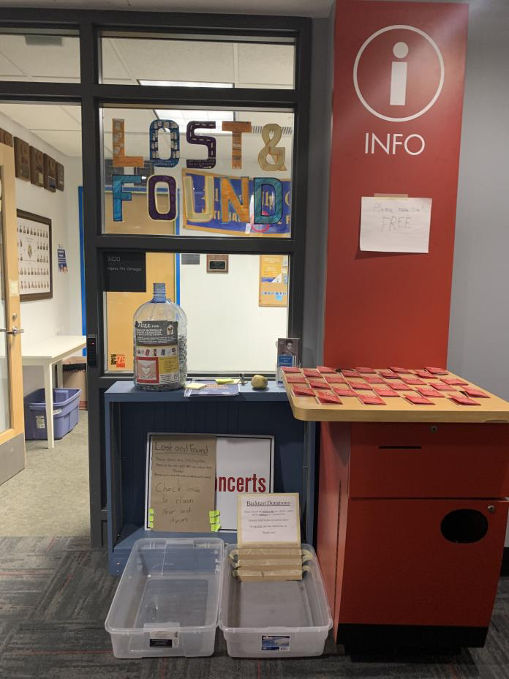
Competitors
Our main competition would be the lost and found located in the union. However we are more interactive and give users the convenience of not having to go all the way to the the Union to see if their missing item was dropped of their. Most times it is not there anyway.
Another platform that could be considered a competitor would be any of the chat platforms used on campus like Webex or Discord.
Notes:
Lubna
For reference here is what the lost and found looks like. Is this a place that looks likes its regularly used? No.
Do many of you even know how to find this corner? Probably not.
Webex and Discord are ok, but with the large amount of messages that are sent on it everyday people miss them and don’t catch them all. With the amount of messages sent over discord and webex each day chats about missing items easily get mixed in and is not seen by many.

Slide 7
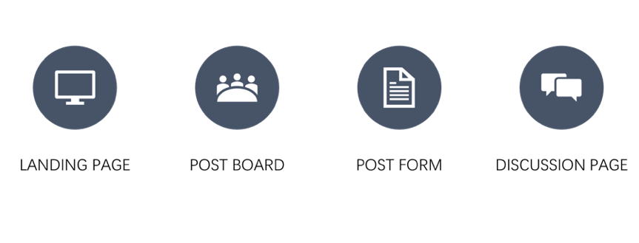
Structure
Notes:
We kept a simple design that way users are not overwhelmed with extra pages or are confused on how to use the lost puck. Since the our app is designed for the rpi community user log in with their RCSID and RIN.
Chloe

Slide 8
Stakeholders
Our Stakeholders include:
RPI Students, this would be our biggest stakeholders because it would be the most beneficial to them.
RPI staff and faculty, out site is designed to be used by not only students but also staff.
Notes:
Chloe
Everyone gains value from this application, because there is no cost to post or access the application, and users will not spend any more money on replacing lost items.

Slide 9

Tech Involved
For this site we used a combination of
HTML, CSS, PHP and Bootstrap.
Notes:
Chloe

Slide 10
Functional Requirements
If a user found their lost item posted on the message board, the user gets to click a 'Claim' button to be directed to the student's email who posted an item on the board.
If a user found an item and would like to post it on the board to find the owner of the item, the user should be able to upload a picture of an item and add a comment or description.
If a user would like to report a lost item on the board, the user should be able to upload a picture of an item and add a comment or description.
If a user found an item and saw the lost item report on the board, the user should click on a "found" button to be directed to the student's email who reported a lost item on the board.
Notes:
Paul

Slide 11
Non-Functional Requirements
Security
User’s privacy is protected as the system hash user’s account info(Password) when storing it in the database
Reliability - will be achieved as we take feedback upon user experience and reflect on them to improve the system.
Performance - Lost Puck should be well built on a server to be accessible from every user's laptop regardless of their location
Scalability & Maintainability – The ability to be increased in size and stably maintained in the future
Usability - Easy Sign-up process, Easy User Interface
Notes:
Paul
For the non-functional requirements,
Security has been strengthened by implementation of password hashing. User’s private info could now be able to be protected as the system hash user’s password before passing it into the database.
2. For reliability, the system will take user feedback upon their experience and reflect them to the future development.
3. For performance, lost puck should have a firm server stability to be accessible from every user’s laptop regardless of their current locations.
4. For scalability and maintainability, the system will increase in terms of size and stably maintained in the future
5. For usability sake, the system has been implemented of an easy sign-up process, and overall easy user interface structure.

Slide 12
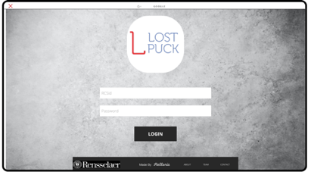
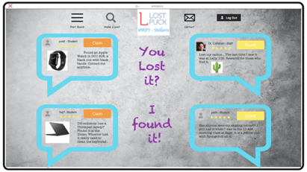
Wireframes
Notes:
In these images above are our original mock up wireframes, which are very different from what we have now. As in the progress of the development, we modified and revised a lot from our original plan. Most of changes were made in terms of the design of the user interface.
Paul

Slide 13
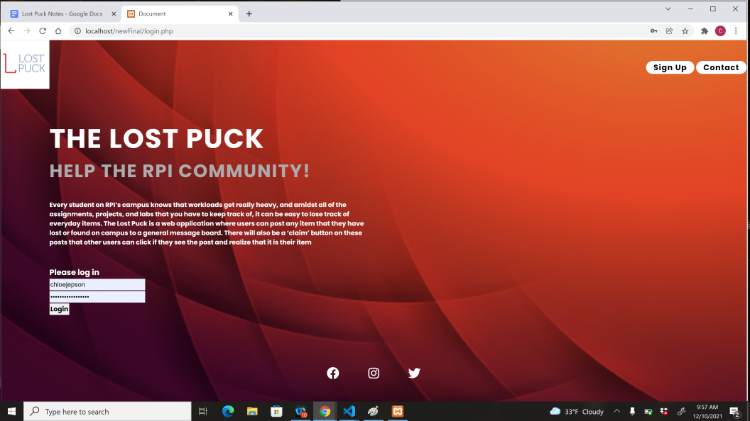
Demo
Notes:
ALL
Lubna- html for all main pages, nav bar, discussion board( DISCUSSION BOARD PAGE)
Chloe- php explanation for posts page, php for login, form validation, (POSTS PAGE, CLAIMED PAGE,)
Paul- (LOGIN PAGE)
Rex- ABOUT US/CONTACT US, nav bar

Slide 14
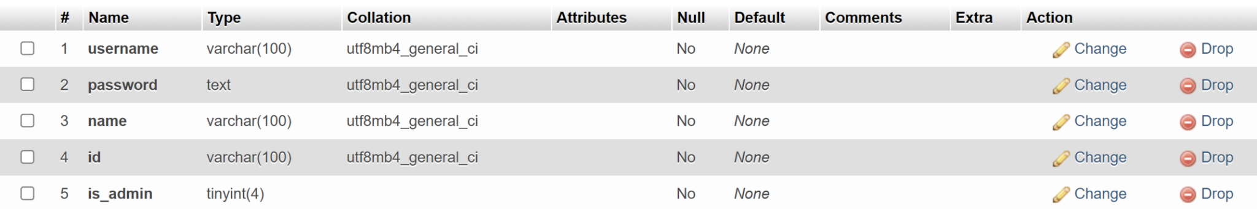
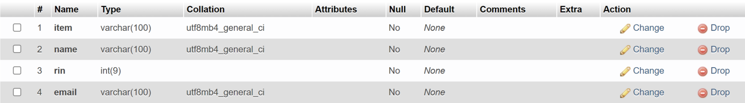
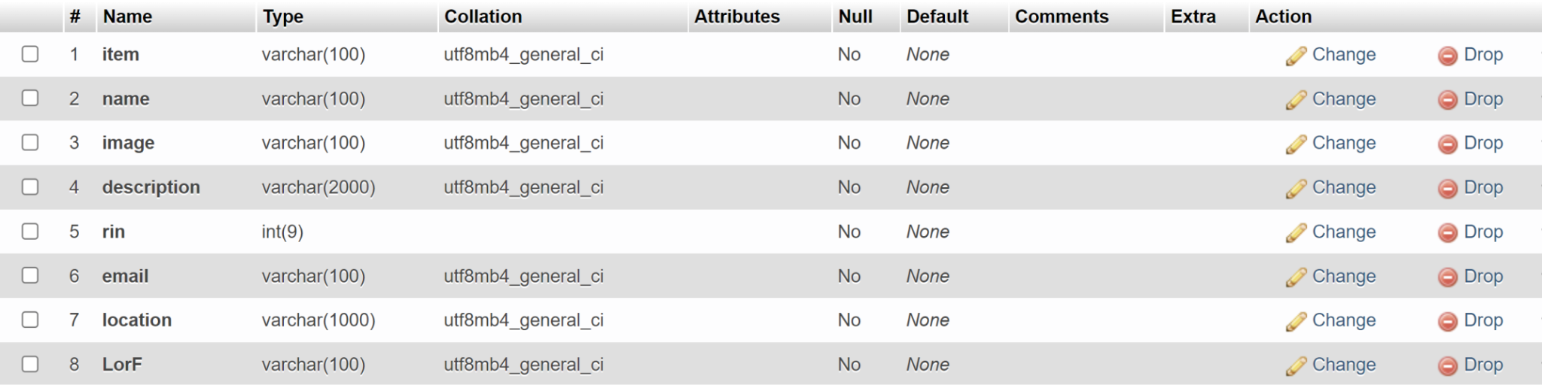
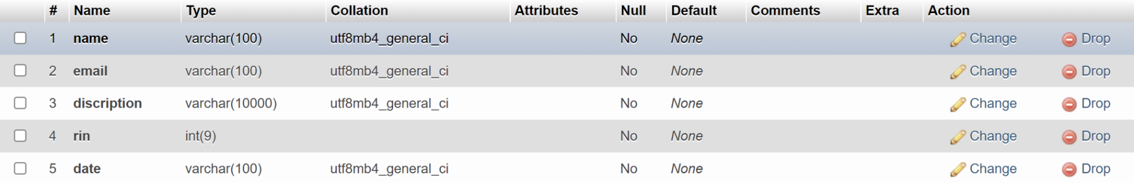
Database
Here are the tables in our database:
The users table:
The found table:
The claim table:
The Discussion table:
Notes:
Chloe

Slide 15
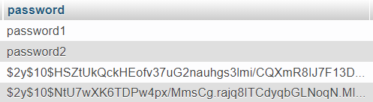
Password Hashing
=> originally, “1234567890”
Notes:
For the system's overall security, we decided to implement password hashing for storing user passwords. As a user first signs up for an account, our Bcrypt password hashing algorithm, which we imported from the open-source, hash the password and pass it to the database.
As you look at the example above, you could see the third row contains a hashed version of the password, which originally was just a number from 1 to 10.

Slide 16
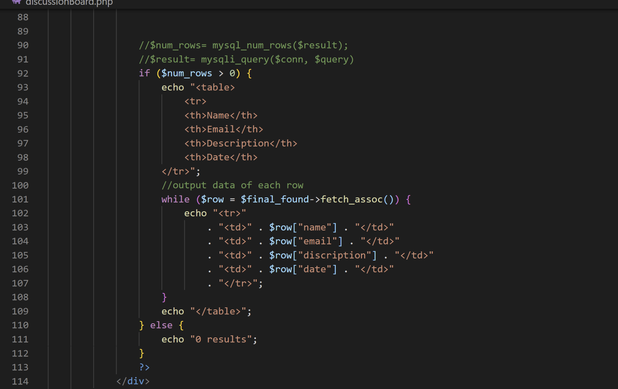
Code for tables (formatting of output of data)
Notes:
Chloe

Slide 17
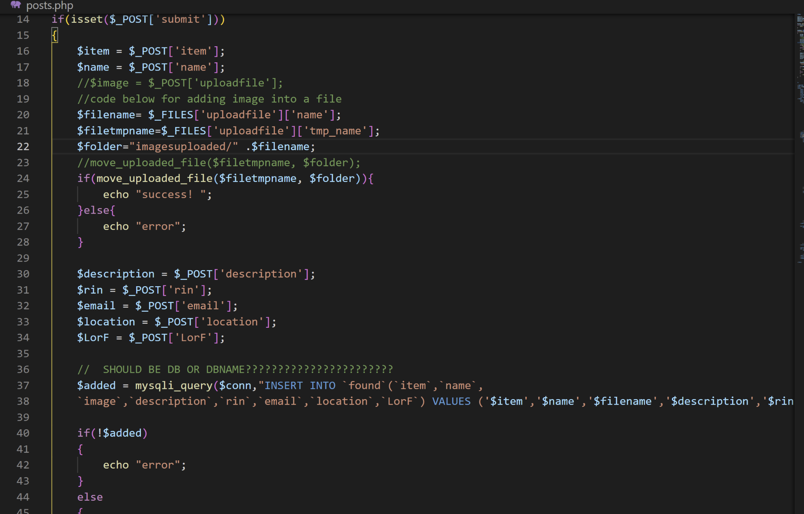
PHP Code for Uploading Info to Database
Notes:
chloe

Slide 18
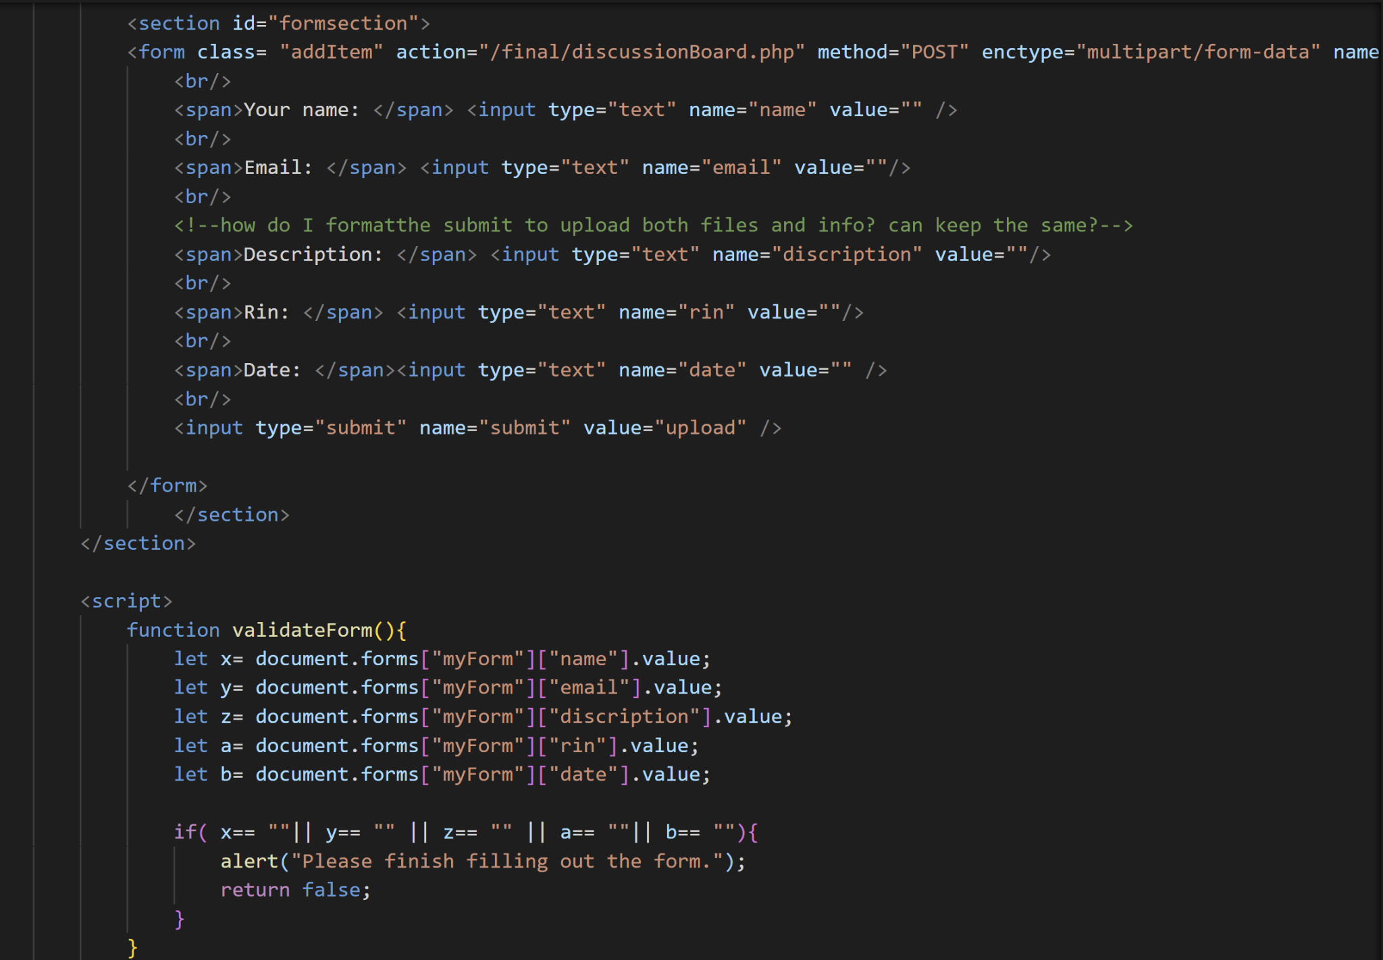
JS For Form Validation
Notes:
chloe

Slide 19
Why Us?
First move advantage
To our knowledge, RPI does not currently have a website with similar functionality to serve its members on campus. Also based on the imperfect functionality of RPI's current lost and found office, we expect our project to be well received.
Free of use
Lost Puck will be totally free for anyone in the RPI community.
Once we can get to collaborate with school tech department, we may make Lost Puck a part of RPI system.
Notes:
rex

Slide 20
Improvements
There are some aspects that we originally planned on including but unfortunately had to cut out. These included:
Having objects on the posts page delete from the table when a user claims them.
Having a feature that allows users to email the person who found their lost item
We had an issue with getting the images on the posts page to load, but it should be a quick fix with how we are directing our files
We had also thought of a page that held all pending items. This would be apage that held items that are in the process of being claimed.
Notes:
Rex

Slide 21
SWOT Analysis
Strength
Focus on daily needs of the community.
Easy to use and access.
No competition.
Weaknesses
May need more developers to help.
Opportunities
Make it based on RPI accounts
Threats
Operations and maintenance.
Notes:
Rex

Slide 22
Future Developments
Search bar for items
Once the total amount uploaded to the Lost Puck is increased, users could need a filter to search for certain type of item information.
Pop-up map for locations
The first thing that comes to mind for people who have lost something is where they went today. If there were a way for users who upload information about found items to provide the address where the item was located when it was found, the owner would be able to check near the building they went to on the map to see if anyone had registered the item as found.
Another feature we wanted to implement was a reward system that would encourage users to help others find their items, however at the moment we don’t know how to best approach it. But we hope to add this feature to the site in the future.
Contents page, this is something we hope to implement in the future
Notes:
rex

Slide 23
Thank you!
Any questions?

